Slide 1
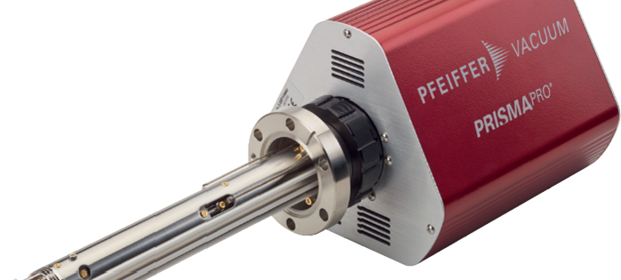

MPP Basics
Communication with PRISMAPRO
A Pfeiffer Vacuum© application

Slide 2
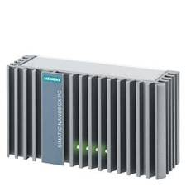
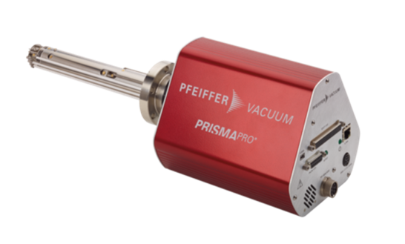
MPP: Application for communication between Mass-Spectrometer PrismaPro and PC / PLC
(MPP: Application for Communication between Mass-Spectrometer PrismaPro and S7-PLC or OPC-UA-Server)
Values/Conditions …
API*** via http
Start/Stop…
S7 / OPC-UA**
Recipe ….
Recipe, Commands…
* Copyright notice: Image source "© Siemens AG 2020, All rights reserved".
** wikipedia: OpenPlatformCommunications-UnifiedArchitecture
*** wikipedia: Application Programming Interface

Slide 3
Main topics:
Establish a connection between a PrismaPro and a Siemens PLC or an OPC-UA-Server
Switch On/Off Emission + EM (and a lot more: See Documentation.pdf)
Read/Write a recipe from/to the PrismaPro (currently 20 Channels/Recipe)
Start/Stop a RUN with „Lock“ and „Release“ the PrismaPro for other Applications
Read the measured values after or during each RUN (max. 3001 Datapoints/RUN)
Cyclic reading: Internal + external Pressure (mBar & Pas & Torr) Faults and Warnings State of Emission, EM, Scan, ….. Digital/Analog Inputs + Outputs (Option)
Feature: Adjust a recipe in PVMassSpec and use with the MPP-application

Slide 4
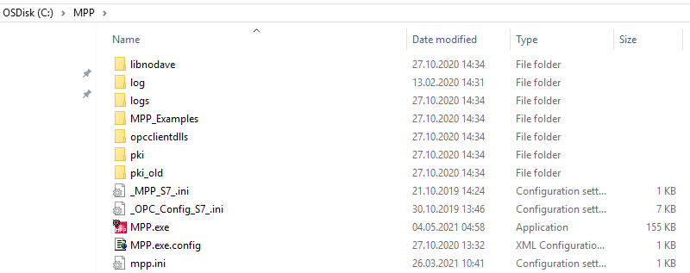
Installation 1/4:
Copy all necessary files into a folder on the disk (recommended is a folder named MPP in the root folder C:\).

Slide 5
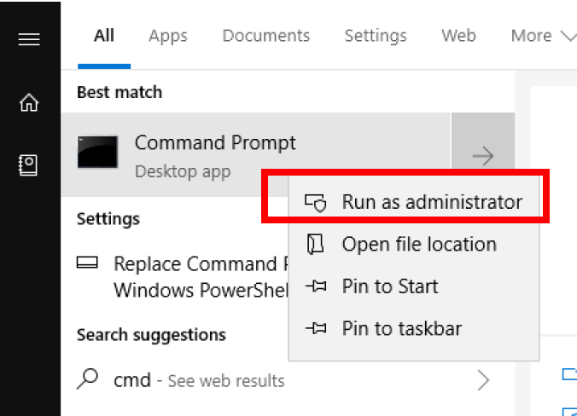
Installation 2/4:
Press Windows key and type in cmd. The best match should be the Command Prompt application which must be started with administrator rights (Right click → Run as administrator).

Slide 6
Installation 3/4:
Type in the following command and confirm it with a press of the Enter key: “C:\Windows\Microsoft.NET\Framework\v4.0.30319\InstallUtil.exe” “C:\MPP\MPP.exe” (See also the „documentation and Interface description“)

Slide 7
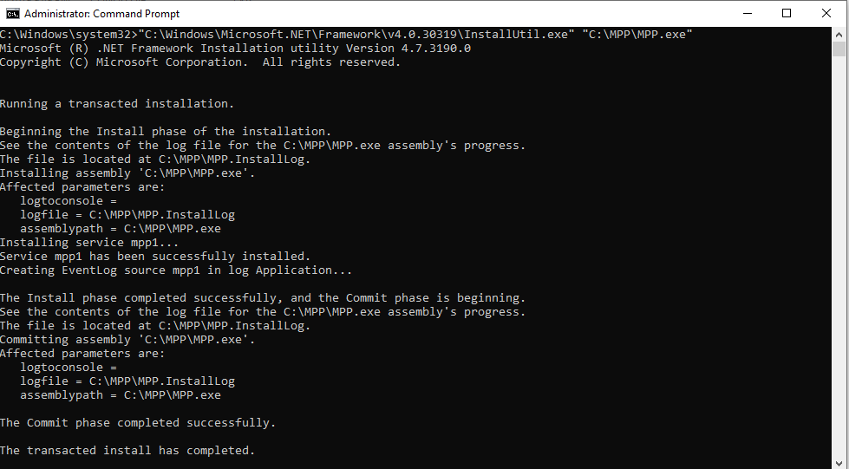
Installation 4/4:
????

Slide 8
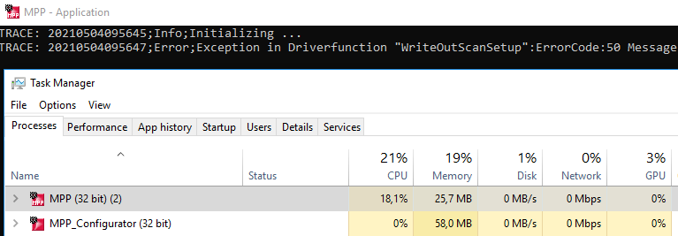
RUN the MPP-Application 1/3:
Without license key*: The application runs only for 2h Start the mpp.exe in the mpp file folder *How to use the license: see „MPP-Configurator“

Slide 9
RUN the MPP-Application 2/3:
With license key: The application runs as a service Restart PC or Start mpp-service manually if the correct license key is activated

Slide 10
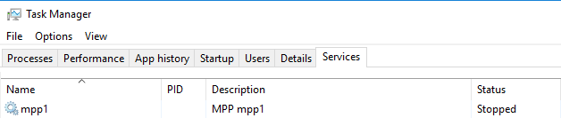
RUN the MPP-Application 3/3:
With the wrong or without a license key*: The MPP service cannot go into the execution (running) mode. Start the mpp.exe in the mpp folder. The application runs only for 2h. *License key and PrismaPro do not belong together or License key misspelled

Slide 11

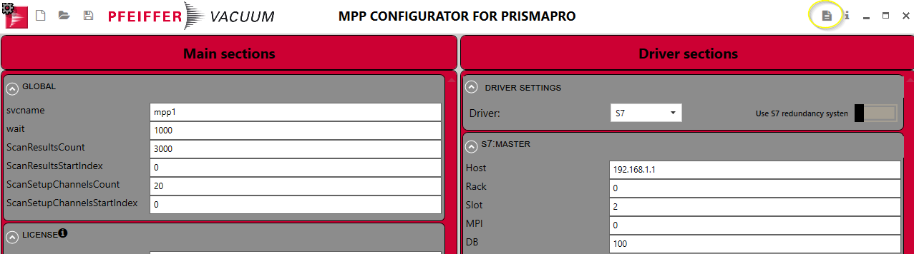
Configuration of MPP 1/4:
Run the MPP-Configurator (Press for more information)

Slide 12
Configuration of MPP 2/4:
MPP.ini Mainly defines the interfaces such as: IP addresses, license, log files, etc.
OPC_Config.ini Defines the individual OPC tags, their spelling and data types in order to be able to communicate with the OPC-UA server as an OPC-UA client.

Slide 13
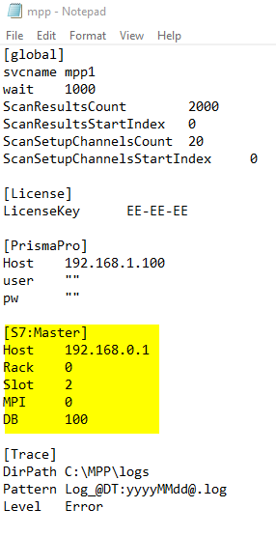
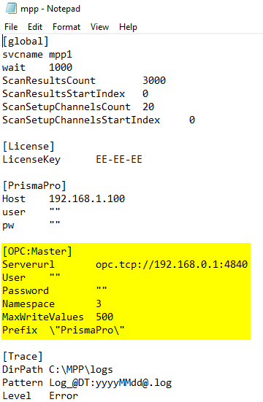
Configuration of MPP 3/4: mpp.ini for S7 and for OPC-UA
S7
OPC-UA The MPP
can only be the Client !!

Slide 14
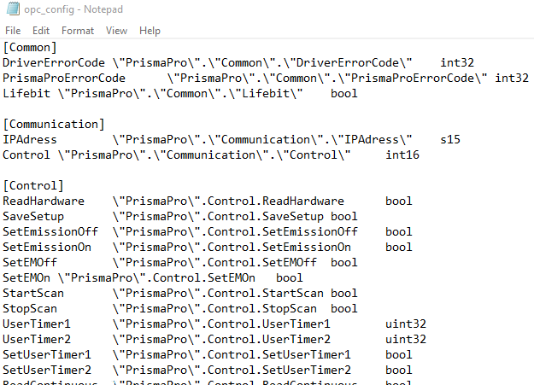
Configuration of MPP 4/4: „OPC_Config.ini“ (OPC-UA only)

Slide 15
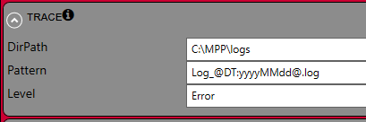
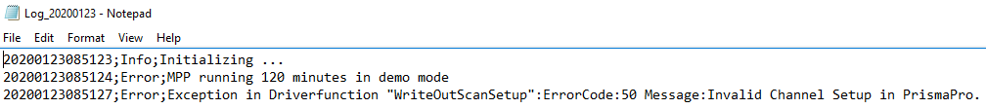
MPP .log-Files:
When the application starts, a new file is created with the current time and date and the ending .log or, if the file already exists, the new entries are appended to the end of the file
If no new entries are made, the application runs without any error. Otherwise the entries can be helpful for troubleshooting

Slide 16
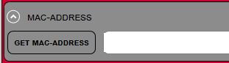
Licensing of MPP: (Without license key the mpp is working for only 2 hours)
The licensing depends on the MAC address of the PrismaPro device
Get the MAC address:
Send this MAC address with your contact details to: QMS@Pfeiffer-Vacuum.de
If you are licensed, you will receive the license key
Fill in the line of the license key in mpp.ini manually or use the MPP-configurator

Slide 17

Save the configuration:
Copy the Configuration to your MPP-Folder (Where the mpp.exe is)
With a text editor, like notepad, you can edit the ini-Files manually
After a new configuration you have to restart the MPP service or the MPP.exe. (It‘s about with or without license key)

Slide 18
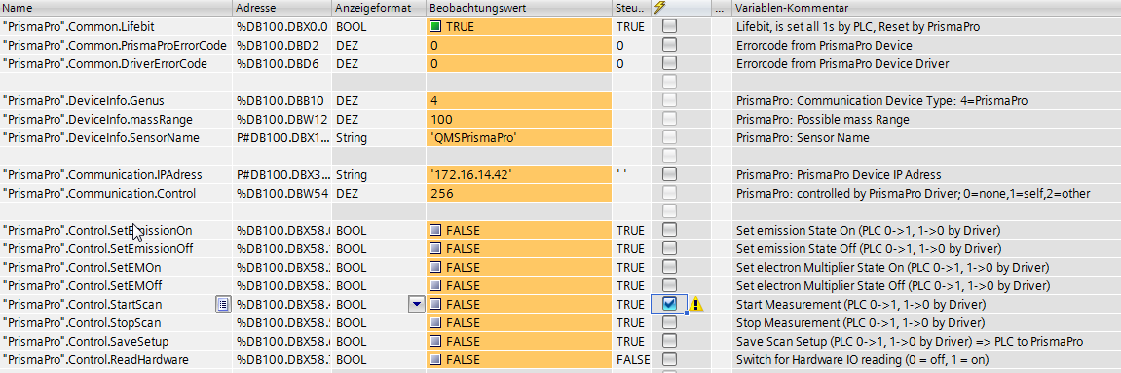
Application MPP ⬄ Siemens PLC 1/3: PLC 1516-3 PN/DP PLC Online (Watch-List)

Slide 19
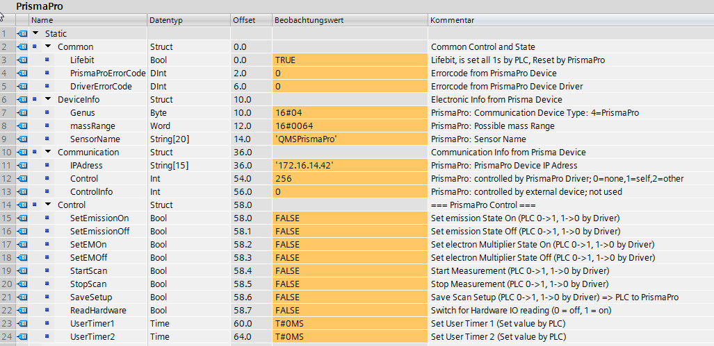
Application MPP ⬄ Siemens PLC 2/3: PLC 1516-3 PN/DP PLC Online (DB100 Part 1)

Slide 20
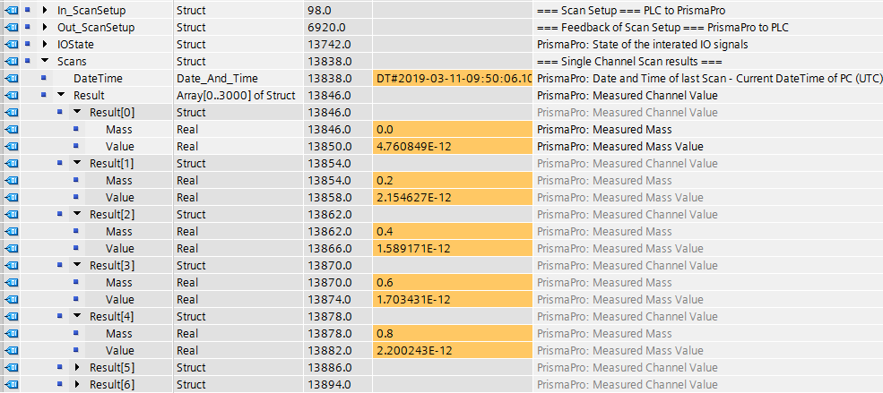
Application MPP ⬄ Siemens PLC 3/3: PLC 1516-3 PN/DP PLC Online (DB100 Part 2)

Slide 21
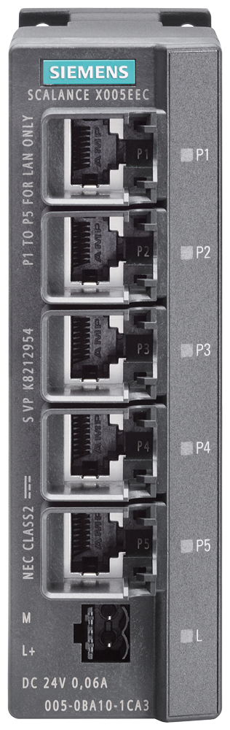

Example: S7 (direct connection)
Siemens Box-PC
(MPP.exe + MPP.ini)
Siemens PLC
S7-300/400/1500
X1: 192.168.1.99
192.168.1.100 (Standard IP-Addr.)
X2: 192.168.1.1
Siemens TIA
192.168.1.101
*Copyright-Hinweis
Bildquelle "© Siemens AG 2020, Alle Rechte vorbehalten“

Slide 22

Example: OPC UA Server
Siemens Box-PC
(MPP.exe + MPP.ini + OPC_CONFIG.ini)
PC: OPC-UA-Client
PC: OPC-UA Server
X1: 192.168.1.199
X1: 192.168.1.99
192.168.1.100 (Standard IP-Addr.)
192.168.1.98
*Copyright notice:
Image source"© Siemens AG 2020, All rights reserved

Slide 23
Example: OPC-UA S7
Siemens Box-PC
(MPP.exe + MPP.ini + OPC_CONFIG.ini)
Siemens PLC
PC: OPC-UA-Client
S7-PLC: OPC-UA-Server
X1: 192.168.1.99
192.168.1.100 (Standard IP-Addr.)
X2: 192.168.1.1
192.168.1.101
*Copyright notice:
Image source"© Siemens AG 2020, All rights reserved

Slide 24

Example: OPC UA KepwareServerEX6
Siemens Box-PC
(MPP.exe + MPP.ini + OPC_CONFIG.ini)
PC: KepwareServerEX 6
PC: OPC-UA-Client
X1: 192.168.1.199
X1: 192.168.1.99
192.168.1.100 (Standard IP-Addr.)
192.168.1.98
*Copyright notice:
Image source"© Siemens AG 2020, All rights reserved

Slide 25
Example: OPC UA Rockwell Automation
Siemens Box-PC
(MPP.exe + MPP.ini + OPC_CONFIG.ini)
PC: OPC-UA-Client
ROCKWELL
Automation
PLC: L30ER
X2: 192.168.1.99 Ethernet 1
X1: 192.168.178.99 Ethernet 2
192.168.1.100
X2 192.168.178.101
OPC-UA-Server
FactoryTalk Linx Gateway
192.168.178.254
*Copyright notice:
Image source"© Siemens AG 2020, All rights reserved

Slide 26
